Slide 1
Chapter 1
Systems of Linear Equations
Notes:
A standard treatment of Gaussian elimination, the rank of a matrix, elementary operations.

Slide 2
Contents
1. Solutions and Elementary Operations
2. Gaussian Elimination
3. Homogeneous Equations
Notes:
stressed the importance of the Elementary Operations

Slide 3
Objectives
Using Gaussian elimination to solve system of linear equations
Using series of elementary row operations to carry a matrix to row – echelon form, find the rank of a matrix.
Condition for a homogeneous system to have nontrivial solution

Slide 4
1.1. Solutions and Elementary Operations
coefficients
variables
a₁x₁+a₂x₂+…+a_{n}x_{n}=b is called a linear equation ( phương trình tuyến tính )
A solution ( nghiệm) to the equation is a sequence s₁,s₂,…,s_{n} such that a₁s₁+a₂s₂+…+a_{n}s_{n}=b
s₁,s₂,…,s_{n} is called a solution to a system of linear equations if s₁,s₂,…,s_{n} is a solution to every equation of the system
A system may have no solution, may have unique solution (nghiệm duy nhất), or may have an infinite family of solutions (vô số nghiệm)

Slide 5
A system that has no solution is called inconsistent (không tương thích)
A system that has at least one solution is called consistent (tương thích)
Inconsistent (không tương thích) | Consistent (tương thích)
No solutions ( vô nghiệm) | Unique solution (nghiệm duy nhất) | Infinitely many solutions (vô số nghiệm)

Slide 6
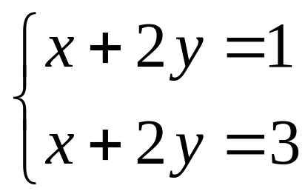
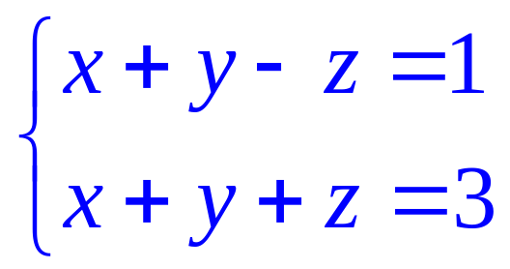
Example 1
no solution
(0,2,1), (2,0,1)
(t,2-t,1)
Inconsistent
Consistent
(infinitely many solutions)
(t,2-t,1) is called a general solution and
given in parametric form , t is parameter
( t is arbitrary)

Slide 7
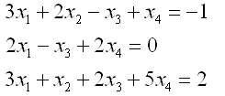
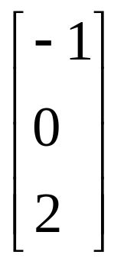
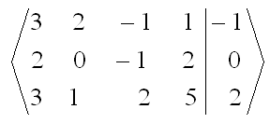
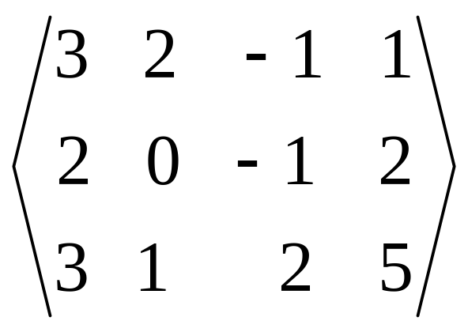
Algebraic Method
constant matrix
(ma trận cột tự do)
augmented matrix
(ma trận mở rộng)
coefficients matrix
( ma trận hệ số)

Slide 8
Elementary Operations
(biến đổi sơ cấp)
Two systems are said to be equivalent if the have the same set of solutions
Difficult
Equivalent
Easy

Slide 9
Elementary Operations
(phép biến đổi sơ cấp)
Interchange two equations (I)
Multiply one equation by a nonzero number (II)
Add a multiple of one equation to a different equation (III)

Slide 10
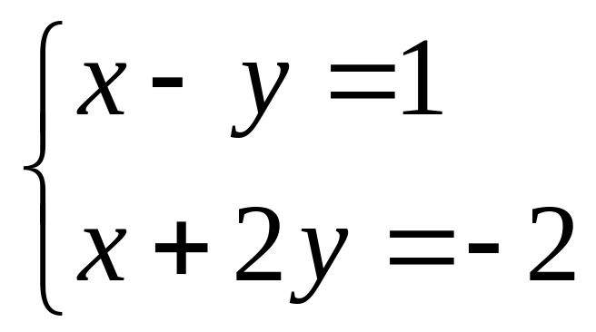
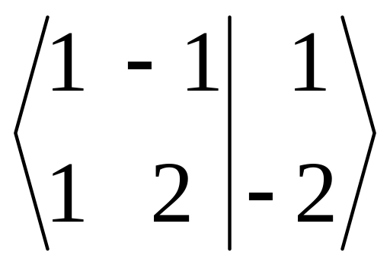
Example 2
Consider the system
augmented matrix

Slide 11
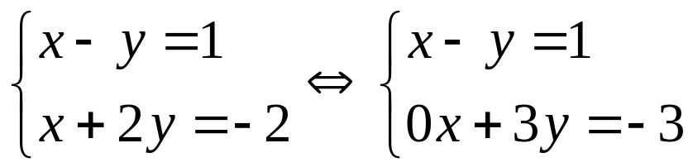
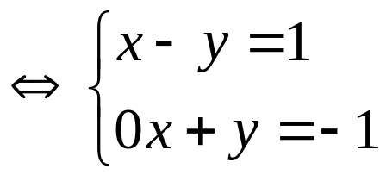
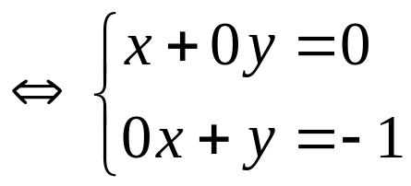
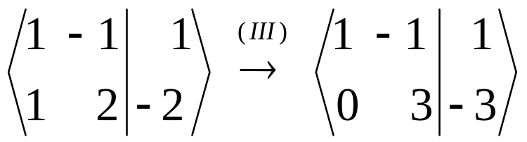
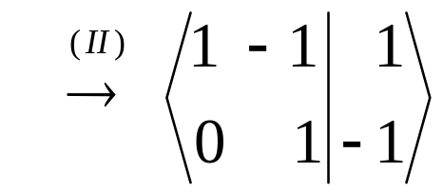
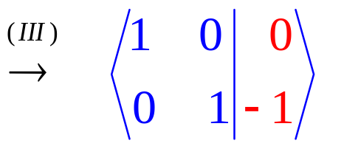
Example 2
Solution (0,-1)
Theorem. Suppose an elementary operation is performed on a system of linear equations. Then the resulting system has the same set of solutions as the original system, so the two system are equivalent (tương đương)
In this case,their augmented matrices are called row-equivalent

Slide 12
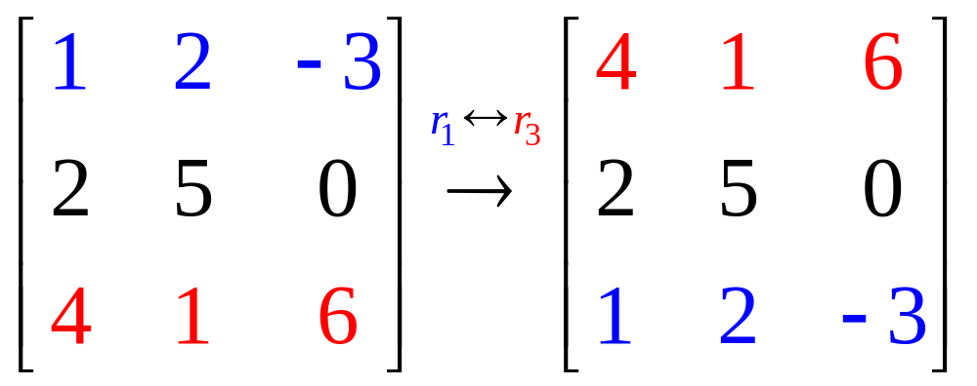
Type I (interchange two rows)

Slide 13
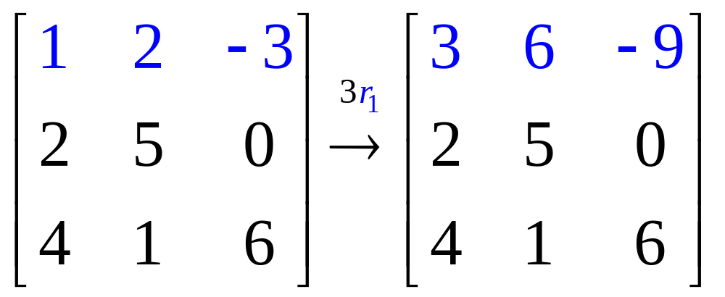
Type II (multiply one row by a nonzero number)

Slide 14
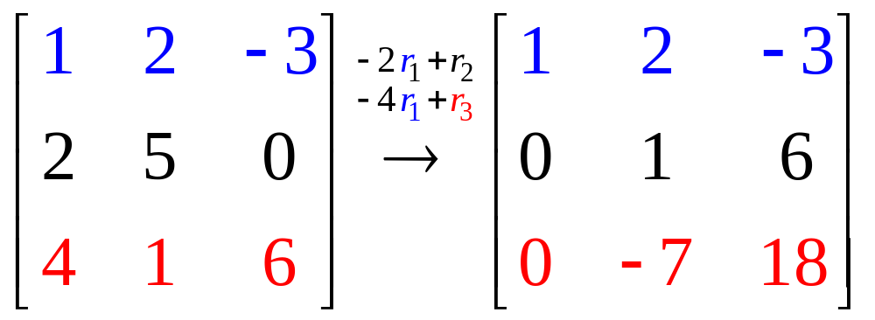
Type III (add a multiple of one row to another row)

Slide 15
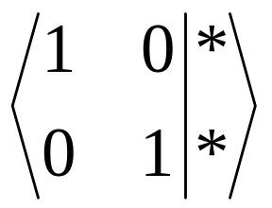
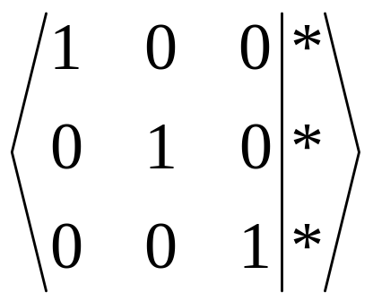
Elementary (row) Operations on matrix
In case of two equations in two variables, the goal is to produce a matrix of the form
In case of three equations in three variables, the goal matrix is

Slide 16
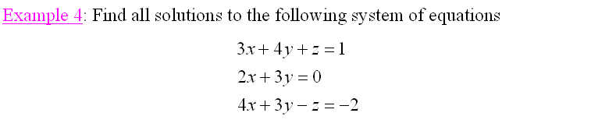

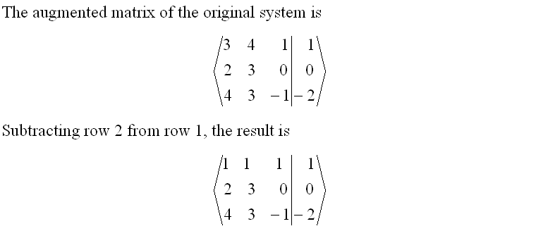

Slide 17
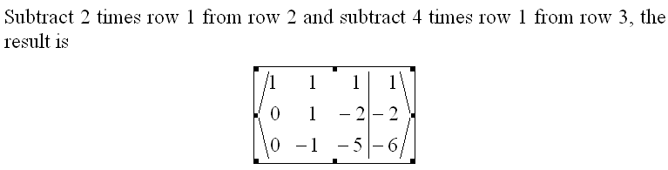
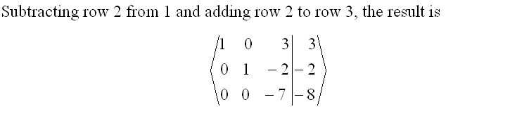
Notes:
1. When the augmented matrix of a system of linear equations has been carried to (deduced) row-echelon form, variable corresponding to columns containing a leading 1 are called leading variable. The non-leading variable are given in terms of parameters.
2. back-substitution for solving a system of linear equations with row-echelon augmented matrix.

Slide 18
1.2. Gaussian Elimination
(phép khử Gauss)
By using elementary row operations to carry the augment matrix to “nice” matrix such as
( and it is said to be in row- echelon form
(dạng bậc thang theo dòng))

Slide 19

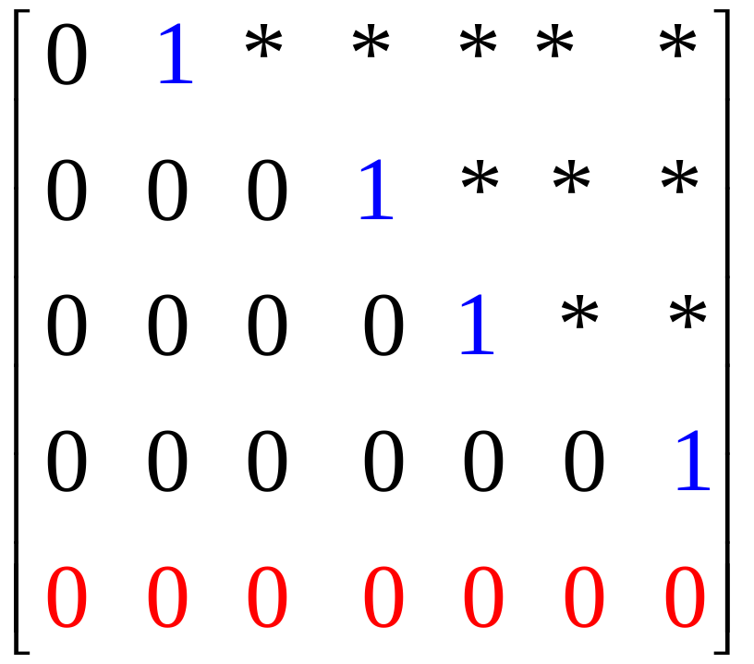
A row-echelon matrix has 3 properties
All the zero rows are at the bottom
The first nonzero entry from the left in each nonzero row is a 1, called the leading 1 for that row
Each leading 1 is to the right of all leading 1’s in the rows above it

Slide 20
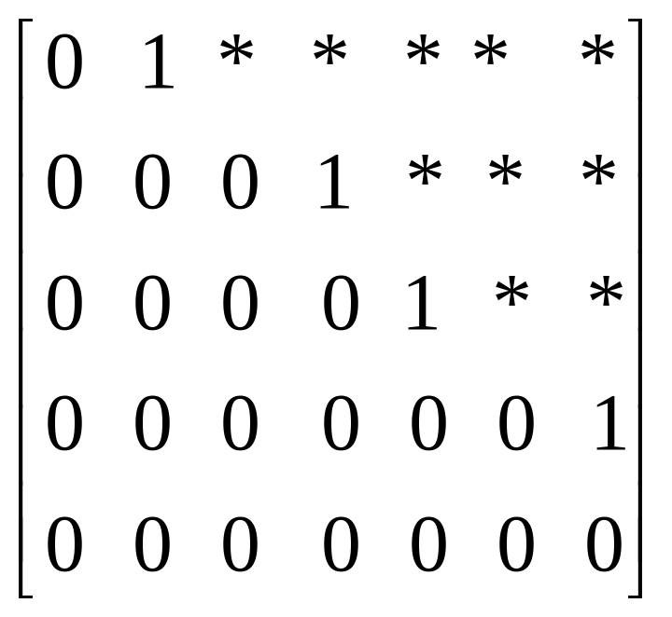
Row-echelon matrix
The row-echelon matrix has the “staircase” form
leading ones
( for any choice in *-position )

Slide 21
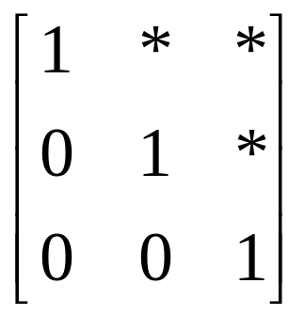
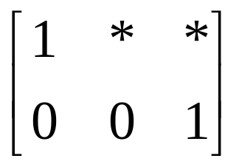
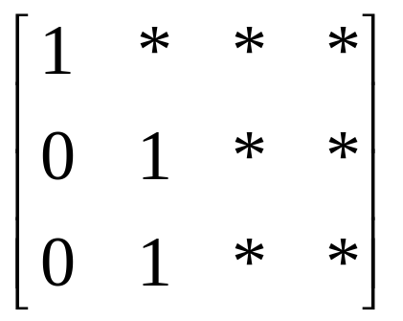
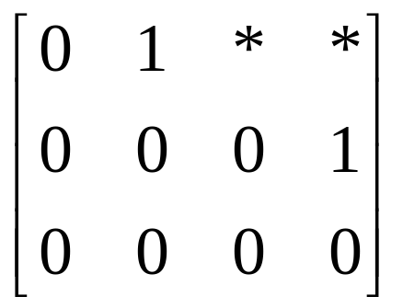
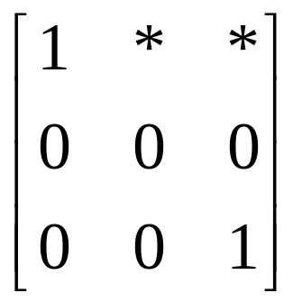
Row-echelon matrix

Slide 22
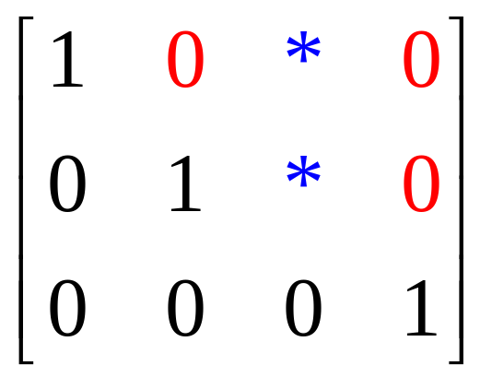
A reduced row-echelon matrix
(ma trận bậc thang theo dòng thu gọn) has the properties
It is a row-echelon matrix
Each leading 1 is the only nonzero entry in its column

Slide 23
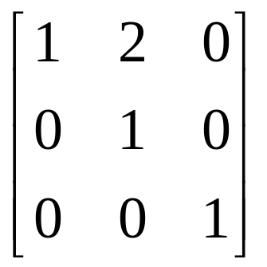
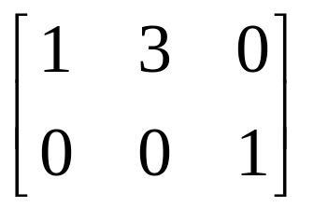
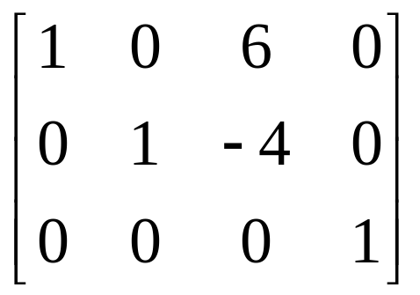
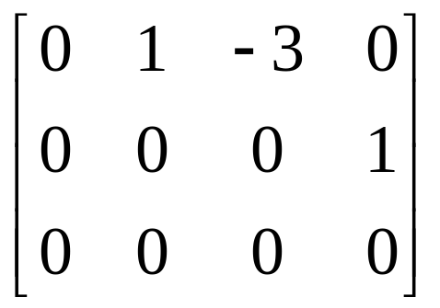
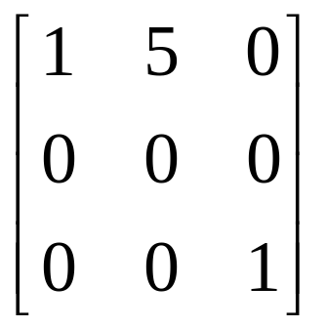
Reduced row- echelon matrix

Slide 24
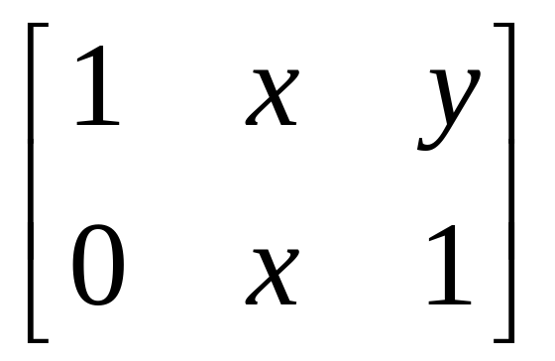
Find x,y so that the matrix
is row-echelon matrix (x = 0, x = 1, y tùy ý)
is reduced row-echelon matrix (x = y = 0)

Slide 25
Gaussian Algorithm
Theorem. Every matrix can be brought to (reduced) row-echelon form by a series of elementary row operations
Step 1. If all row are zeros, stop
Step 2. Otherwise, find the first column from the left containing a nonzero entry (call it a) and move the row containing a to the top position
Step 3. Multiply that row by 1/a to create the leading 1
Step 4. By subtracting multiples of that row from the rows below it, make each entry below the leading 1 zero
Step 5. Repeat step 1-4 on the matrix consisting of the remaining rows

Slide 26
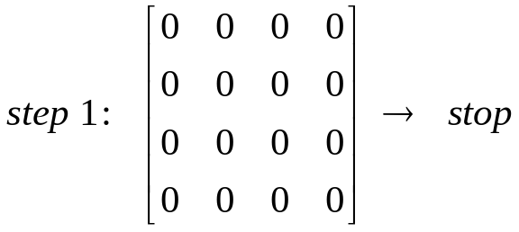
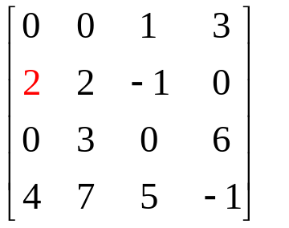
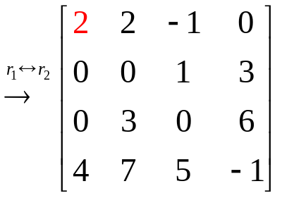
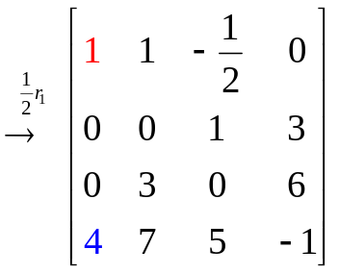
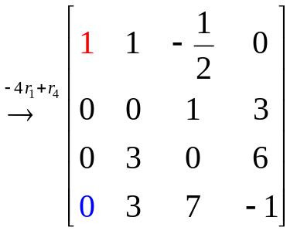
Gaussian Algorithm
leading one
step 2
step 3
step 4
step 5

Slide 27
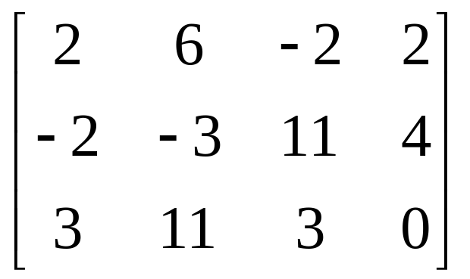
Example
Carry the matrix
to row-echelon matrix
to reduced row-echelon matrix

Slide 28
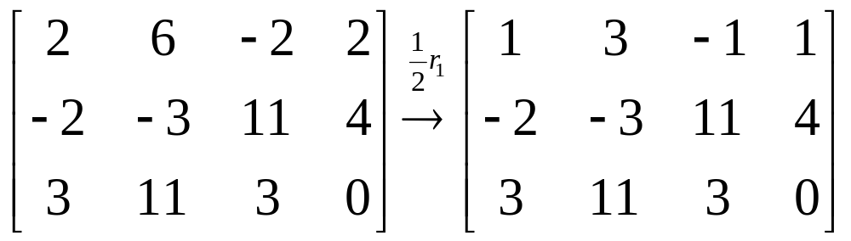
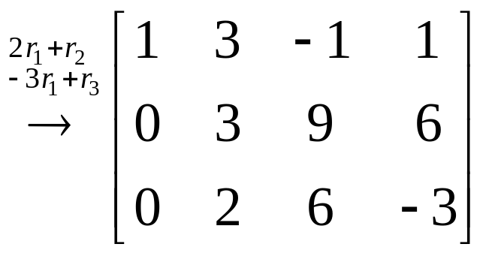
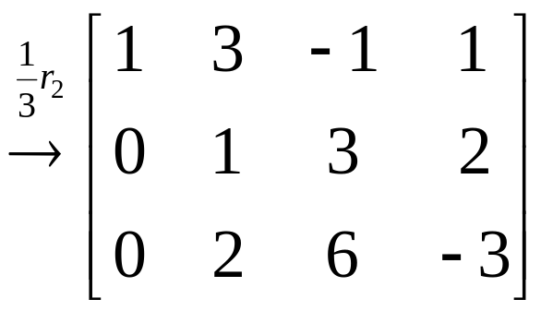
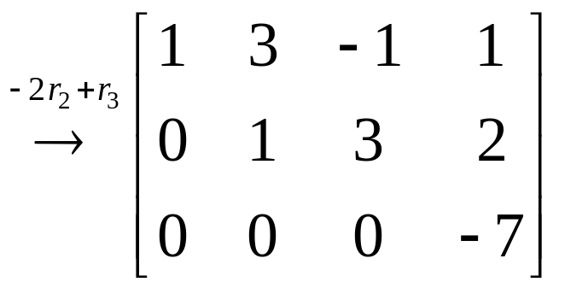
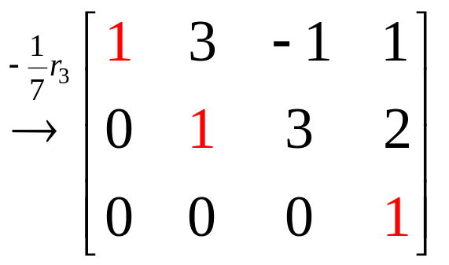
row-echelon matrix

Slide 29
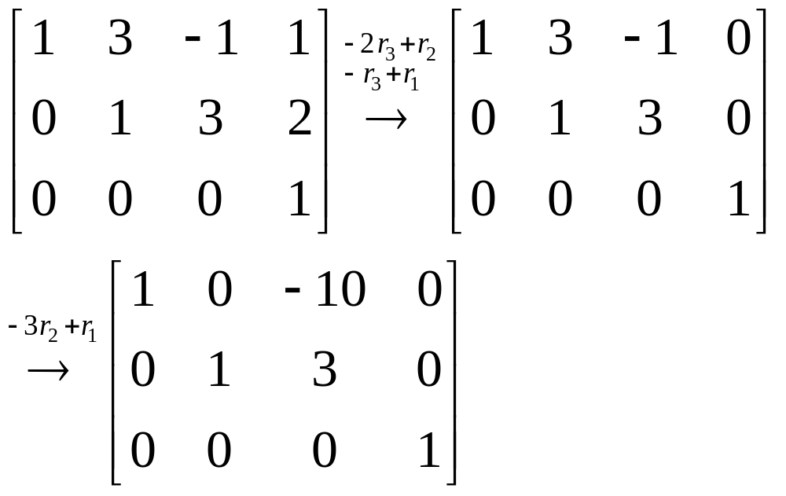
reduced row-echelon matrix

Slide 30
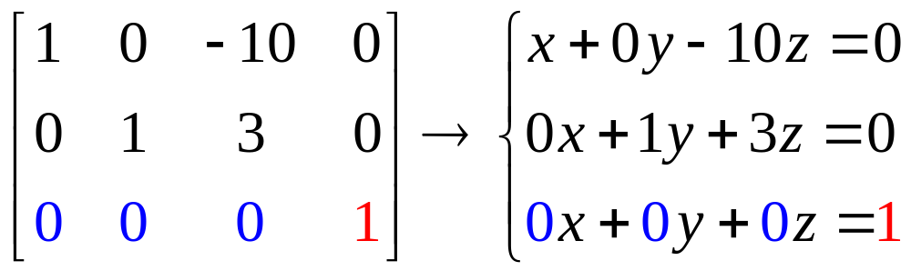

Gauss-Jordan Elimination
(for solving a system of linear equations)
Step 1.Using elementary row operations, augmented matrix→reduced row-echelon matrix
Step 2. If a row [0 0 0…0 1] occurs, the system is inconsistent
Step 3. Otherwise, assign the nonleading variables as parameters, solve for the leading variables in terms of parameters
reduced row echelon matrix
z=t (parameter)
z is nonleading variable

Slide 31
reduced row echelon matrix

Slide 32


row echelon matrix
inconsistent

Slide 33


leading one
row echelon matrix
x₂,x₄ are nonleading variables, so we set
x₂=t and x₄=s (parameters) and then compute x₁, x₃

Slide 34

Example
Which condition on the numbers a,b,c is the system
consistent ? unique solution?

Slide 35
The rank of a matrix
The reduced row-echelon form of a matrix A is uniquely determined by A, but the row-echelon form of A is not unique
The number r of leading 1’s is the same in each of the different row-echelon matrices
As r depends only on A and not on the row-echelon forms, it is called the rank of the matrix A, and written r=rankA
Notes:
The number of leading 1’s depends only on A and not on way in which A is carried to row-echelon form.

Slide 36
The rank of a matrix
If the a matrix A has the row-echelon matrix is
then rankA=4

Slide 37



Slide 38
Theorem 2
Suppose a system of m equations in n variables has a solution. If the rank of the augment matrix is r then the set of solutions involves exactly n-r parameters
leading one
rankA=2
4(number of variables)- 2(rankA) =2 (two parameters : x₂=t, x₄=s)

Slide 39
1.3.Homogeneous Equations
(phương trình thuần nhất)
The system is called homogeneous (thuần nhất) if the constant matrix has all the entry are zeros
Note that every homogeneous system has at least one solution (0,0,…,0), called trivial solution (nghiệm tầm thường)
If a homogeneous system of linear equations has nontrivial solution (nghiệm không tầm thường) then it has infinite family of solutions (vô số nghiệm)
Notes:
Our chief goal in this section is to give a useful condition for a homogeneous system to have nontrivial solutions.

Slide 40


Slide 41



Slide 42
Theorem 1
If a homogeneous system of linear equations has more variables than equations, then it has nontrivial solution (in fact, infinitely many)
Note that the converse of theorem 1 is not true
Notes:
For example that the converse of theorem 1 is not true

Slide 43
Summary
System of | Inconsistent ( no solutions) | Consistent
 |  | Unique solution (exactly one solution) | Infinitely many solutions
linear equations | yes | yes | yes
linear equations that has more variables than equations | yes | no | yes
homogeneous linear equations | no | yes | yes
homogeneous linear equations that has more variables than equations | no | no | yes

Slide 44
THANK YOU

